Slide 1



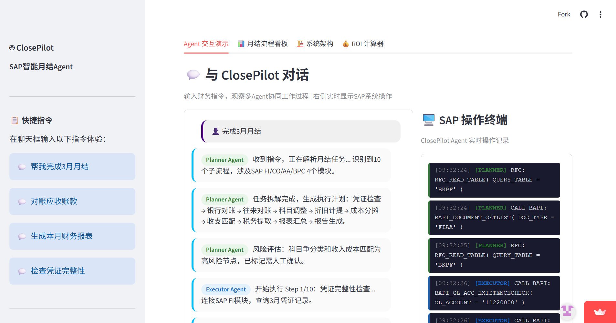
ClosePilot - SAP智能月结Agent
ClosePilot是AI驱动的SAP智能月结Agent，通过自然语言对话自动编排月结流程。核心能力：一是配置化流程引擎，业务顾问通过YAML配置即可适配不同客户，零代码开发；二是知识沉淀闭环，AI记录历史处理方案，下次自动给出匹配建议；三是智能联络，自动识别责任人并生成邮件草稿，可编辑后一键发送；四是Human-in-the-Loop治理，高风险操作必须人工确认。月结耗时从5-7天压缩至2小时，效率提升83%。 ClosePilot is an AI-powered SAP month-end closing Agent that automates financial close workflows through natural language. Core capabilities: (1) Configurable process engine — business consultants adapt workflows via YAML, zero coding; (2) Knowledge accumulation — AI records historical solutions and auto-suggests matches; (3) Smart contact — auto-identifies responsible parties and generates editable email drafts; (4) Human-in-the-Loop governance — high-risk operations require manual confirmation. Closing time reduced from 5-7 days to 2 hours, 83% efficiency gain.
Demo的截图/5秒内的视频片段
演讲人:
团队成员：Yuyang.a.hao; binyan.chen; yixi.a.li
RP:
2026埃森哲大中华区AI创新大赛总决赛
Greater China AI Innovation Contest 2026 Grand Final

